Slide 1

Facial Expression Recognition
Using Convolutional Neural Networks
Presented By Joey Navarro, Data Scientist
Image References:
https://www.kairos.com/blog/face-detection-explained

Slide 2
Agenda
Introduction
Problem Statement
Required Toolkit
Dataset Used
Neural Network Framework Used
Data Preprocessing and Model Preparation
Model Training Loop
Model Architectures
Model Results
Prediction Examples

Slide 3

Introduction.
Individuals on the autism spectrum often struggle understand others emotions through their facial expressions and other features.
What if there was a way to detect emotion based off of facial expressions to help individuals on the autism spectrum identify how others feel?
Image Source: freepik.com

Slide 4
Problem Statement
Why use a deep convolutional neural network for this task?
Utilize pre-classified images to train a model for the purpose of facial expression recognition using a deep convolutional neural network.
Deep learning excels in recognizing objects in images as it’s implemented using 3 or more layers of artificial neural networks where each layer is responsible for extracting one or more feature of the image.

Slide 5

What I Need - Toolkit
Pre-Classified Data (CK+ Data Set)
Neural Network Framework (Pytorch)
OpenCV (Computer Vision Library)
Matplotlib library
Numpy library
Model Architecture (VGG19 & ResNet18)
NVIDIA CUDA Capable Graphics Card with at least 6GB Memory
Windows or Linux OS Computer

Slide 6






Pre-Classified Data - Cohn-Kanade+ (CK+) Data Set
Compiled by Jeffrey Cohn, and Takeo Kanade at Carnegie Mellon University Robotics Institute and The University of Pittsburgh Department of Psychology Respectively for Disney Research.
The CK+ dataset is an extension of the CK dataset.
The original dataset contains 327 labeled facial videos.
The dataset used here is composed of the last three frames from each video in the CK+ dataset, therefore it contains a total of 981 facial expressions.
Not original dataset used in project modeling.

Slide 7

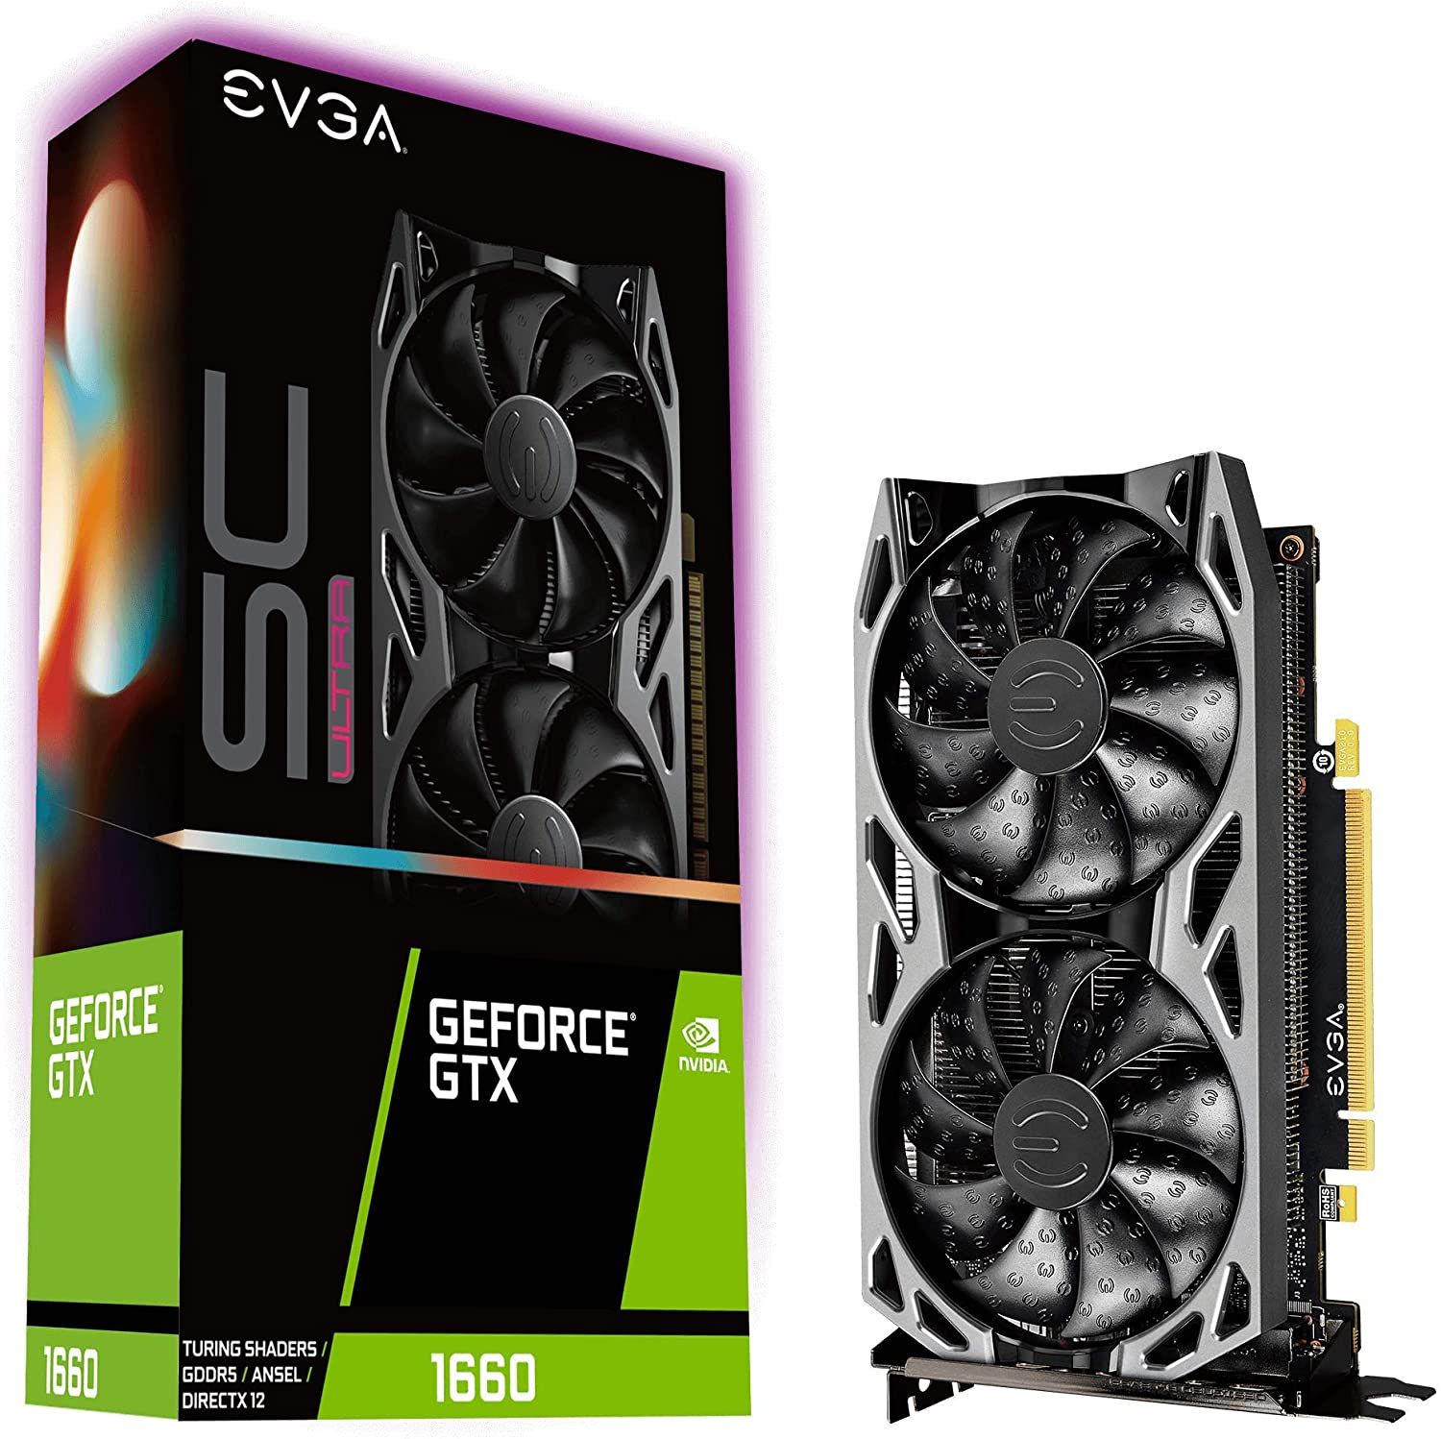
Neural Network Framework - Pytorch
NVIDIA CUDA Capable Graphics Card with at least 6GB Memory
1. PyTorch is Pythonic
2. Easy to learn
3. Higher developer productivity
4. Easy debugging
5. Data Parallelism
EVGA GeForce GTX 1660 SC Ultra
Notes:
1. PyTorch is Pythonic
Python is one of the most popular language used by data scientists. When I use the term “Pythonic”, I mean that PyTorch is more attached to or leaning towards Python as its primary programming language. Perhaps not coincidentally, Python is also one of the most popular languages used for building machine learning models and for ML research.
PyTorch is built to be seamlessly integrated with Python and its popular libraries like NumPy. Check out the code snippet below to see how easy it is to manipulate a NumPy array using PyTorch:
2. Easy to learn
PyTorch is comparatively easier to learn than other deep learning frameworks. This is because its syntax and application are similar to many conventional programming languages like Python.
PyTorch’s documentation is also very organized and helpful for beginners. And a focused community of developers are also helping to continuously improve PyTorch.
3. Higher developer productivity
PyTorch is very simple to use, which also means that the learning curve for developers is relatively short.
PyTorch has a simple Python interface and provides a simple yet powerful API. PyTorch can also be easily implemented on both Windows and Linux.
PyTorch is easier to learn as it is not a completely different syntax for someone coming from programming background. The code below demonstrates that general programming practices like implementing variables, random numbers, square, and multiplication syntax are all very intuitive.
4. Easy debugging
As PyTorch is deeply integrated with Python, many Python debugging tools can also be used in PyTorch code. Specifically, Python’s pdb and ipdb tools can be used for this kind of debugging in PyTorch.
Python’s IDE PyCharm also has a debugger can also be used to debug PyTorch code. All this is possible as a computational graph in PyTorch that’s defined at runtime.
If you’re getting error in your code, you can start debugging by placing breakpoints using pdb.set_trace() at any appropriate line in your code. Then you can execute further computations and check the PyTorch Tensors or variables and nail down the root cause of the error.
5. Data Parallelism
PyTorch has a very useful feature known as data parallelism. Using this feature, PyTorch can distribute computational work among multiple CPU or GPU cores.
This feature of PyTorch allows us to use torch.nn.DataParallel to wrap any module and helps us do parallel processing over batch dimension.

Slide 8
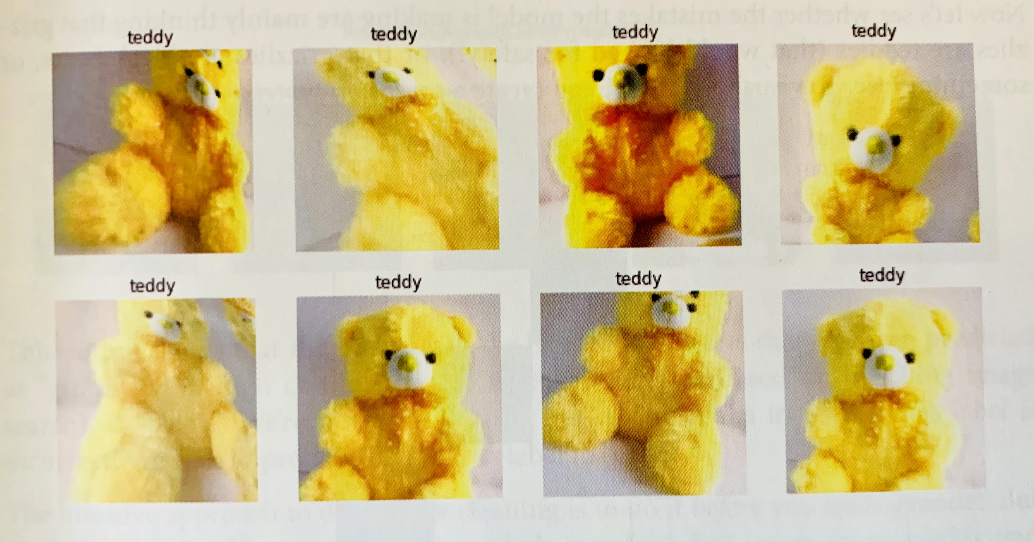
Data Preprocessing and Preparing Model
Read images as pixel arrays for 48 x 48 pixel images for each emotion.
Flattened the arrays into an integer list.
Scaled data by a factor of 3 (limited by GPU memory).
Create training dataset from a random ⅓ of all images.
Setup augmentation by creating random variation transformations.
Set up 10 Fold K-Fold cross validation.
Example of random image data transformations

Slide 9
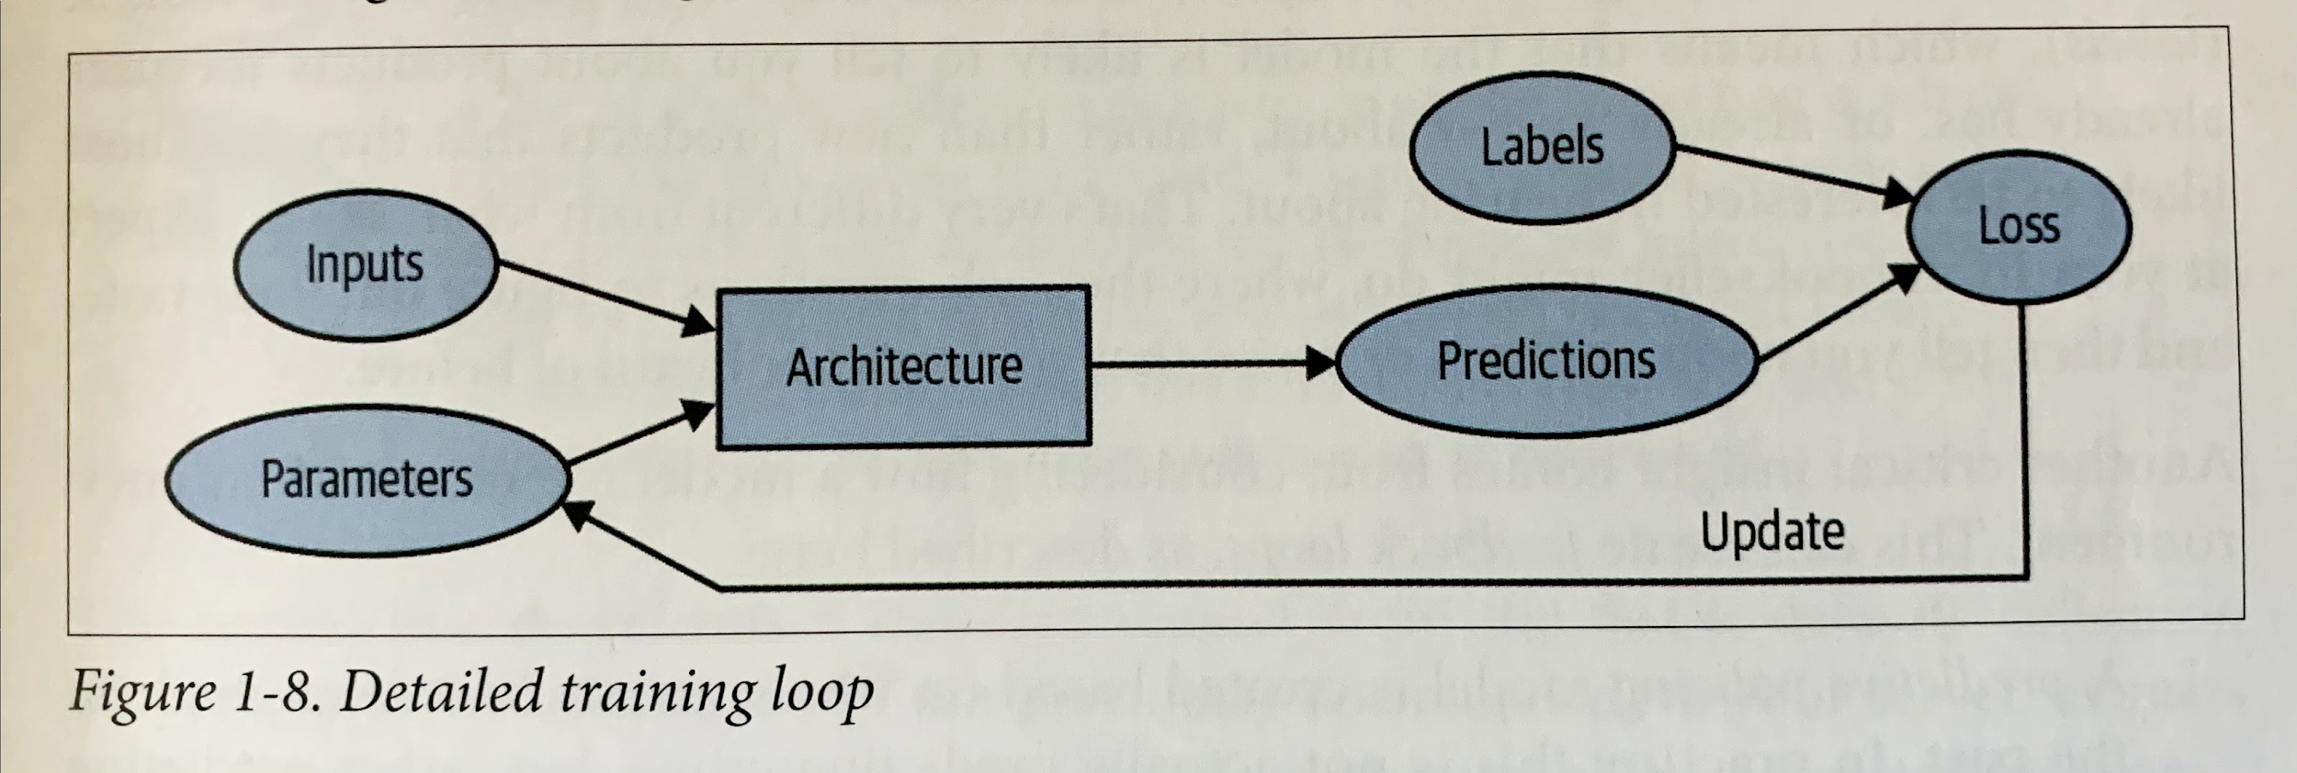
Model Training Loop
Image Classification Label
Flattened Image Pixel Arrays
Training/Testing
Neural Network

Slide 10
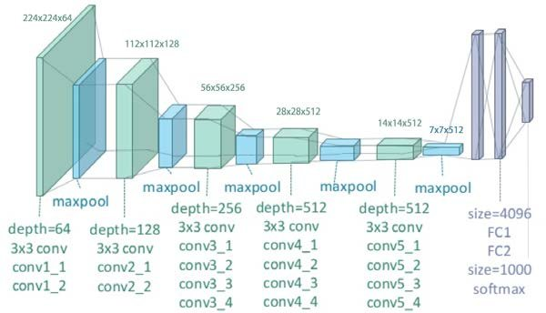
Model Architecture - VGG19
This architecture's name comes from it's founding group at Oxford, namely Visual Geometry Group (VGG).
The 19 after the name stands for the number of layers in the network.
This network can be used for transfer learning, therefore it may also be used for facial recognition tasks.
It is built by stacking convolutions together but the model’s depth is limited because of an issue called diminishing gradient. This issue makes deep convolutional networks difficult to train.
VGG19 Architecture

Slide 11
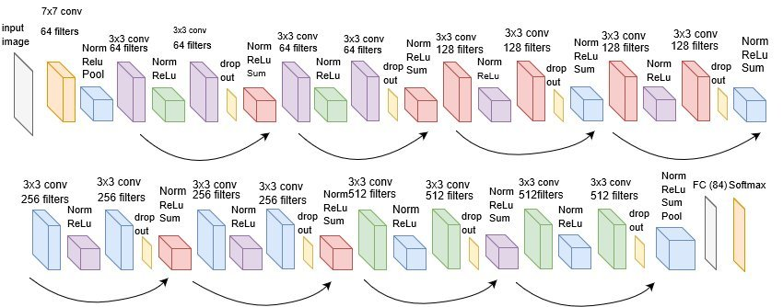
Model Architecture - ResNet18
This architecture's name comes from the functions used by the network, namely residual learning functions or Residual learning Network (ResNet).
The 18 after the name stands for the number of layers in the network. Resnet model was proposed to solve the issue of diminishing gradient.
The idea is to skip the connection and pass the residual to the next layer so that the model can continue to train.
With Resnet models, CNN models can go deeper and deeper.
ResNet18 Architecture

Slide 12
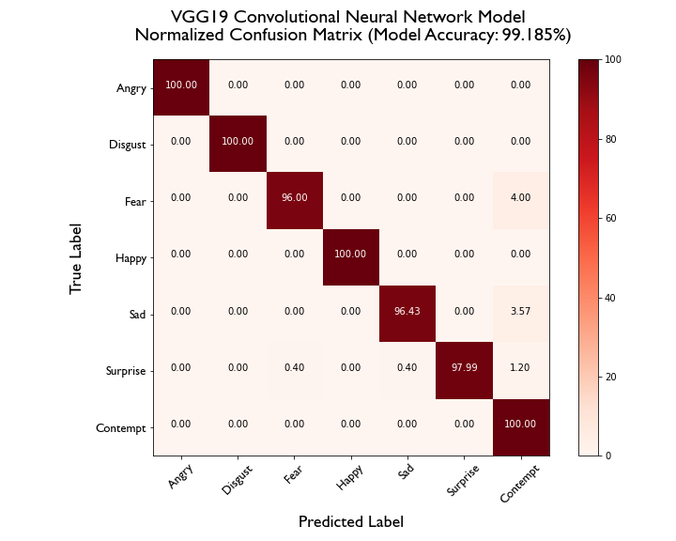
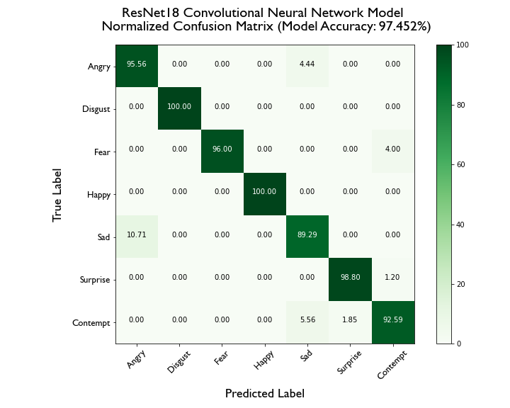
Running the Models - Confusion Matrices

Slide 13
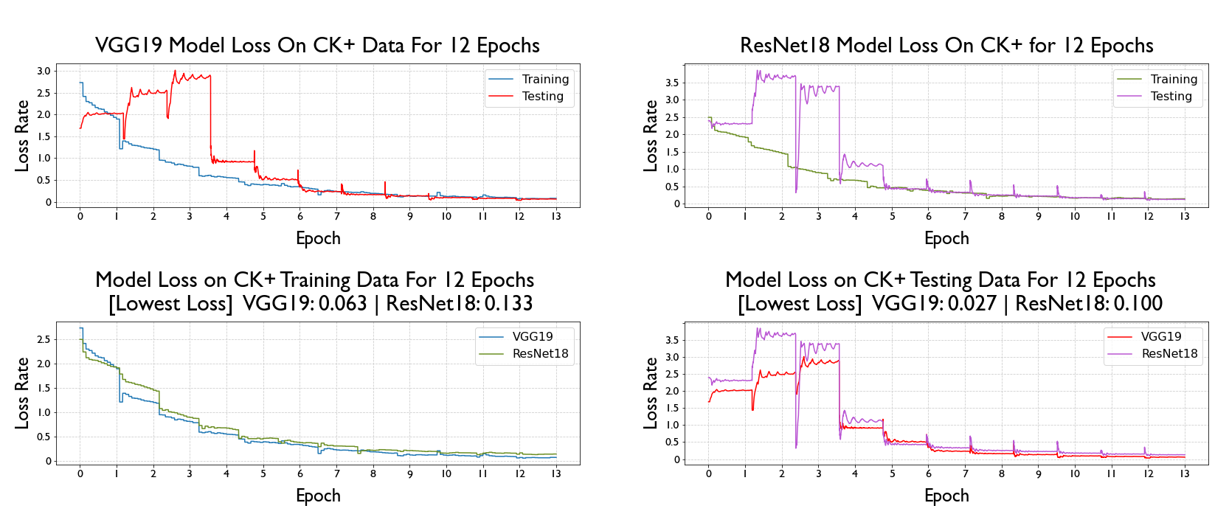
Running the Models - Loss

Slide 14
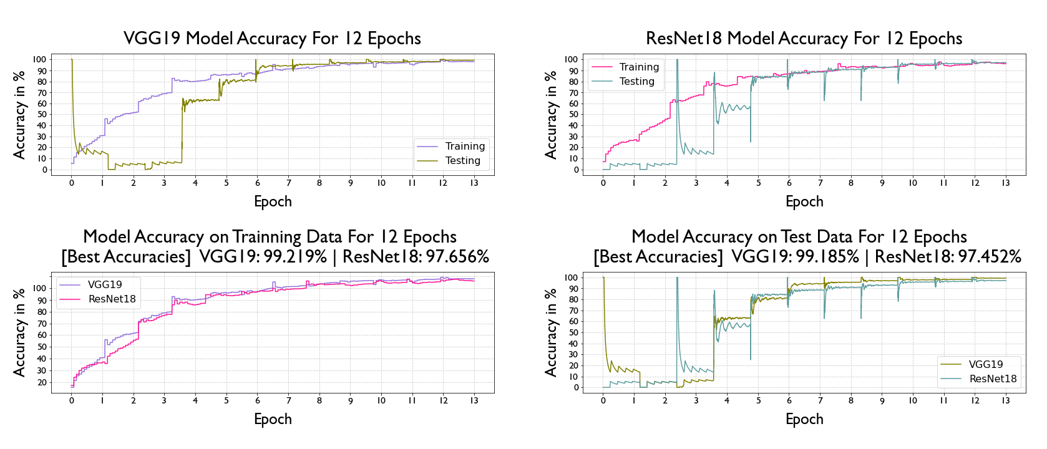
Running the Models - Accuracy

Slide 15
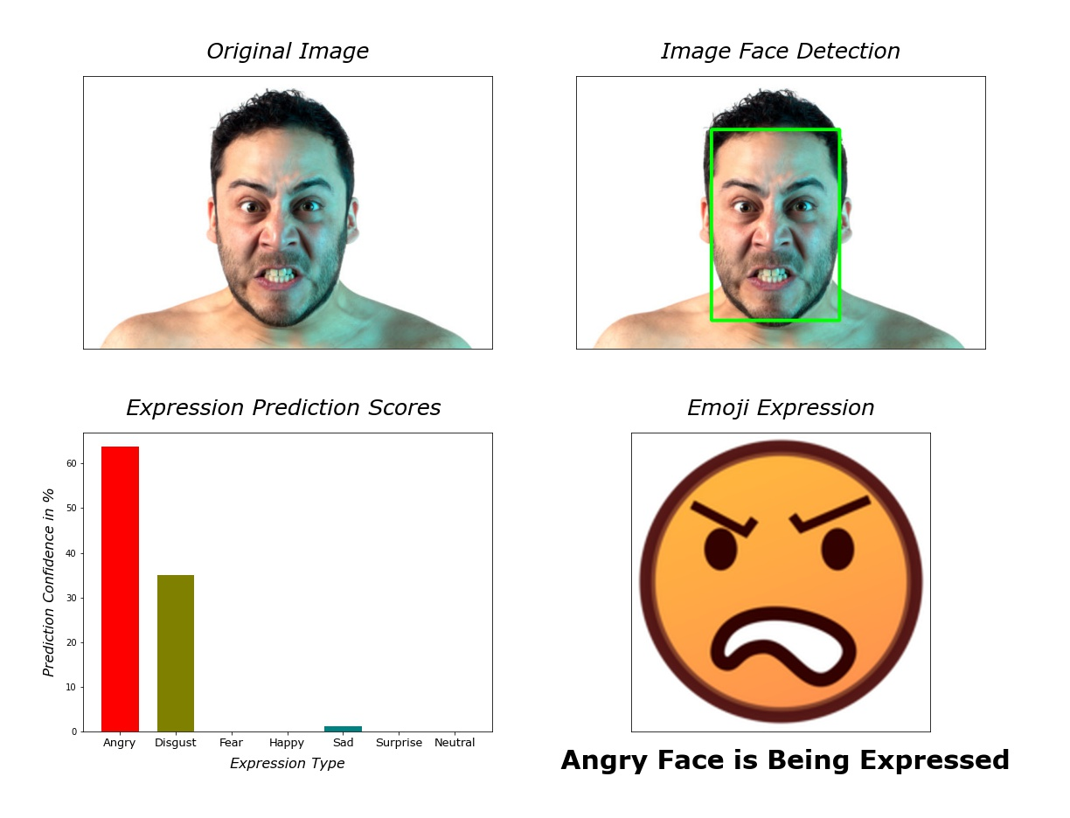
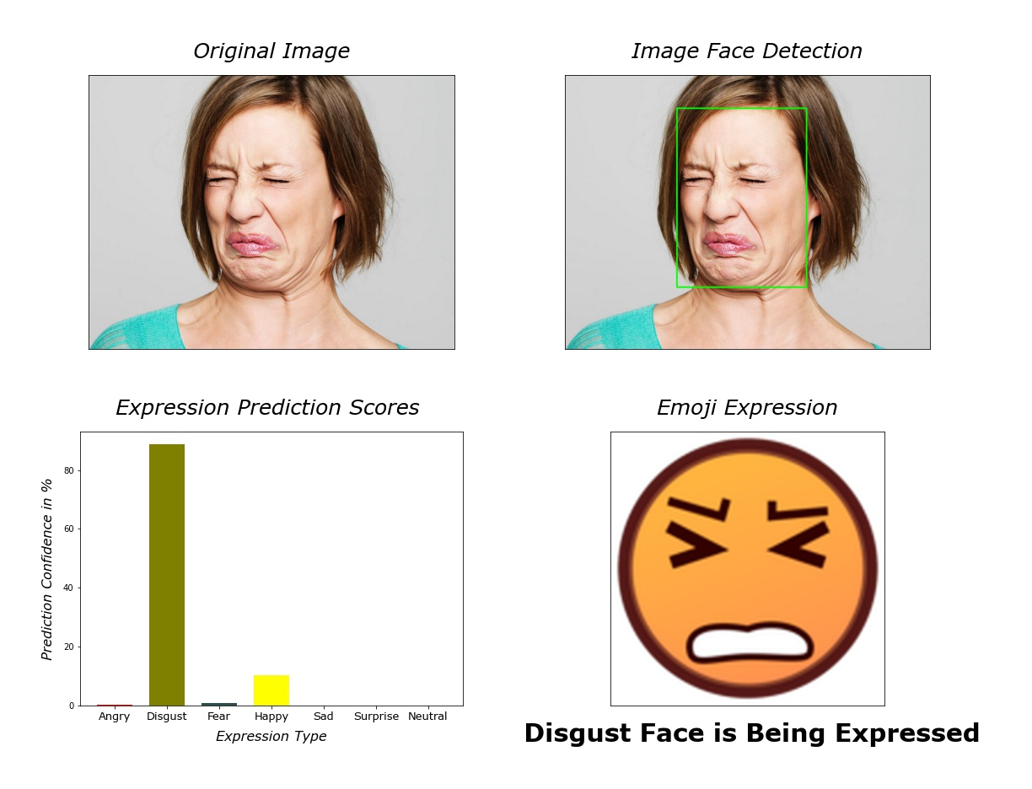
Prediction - Example

Slide 16
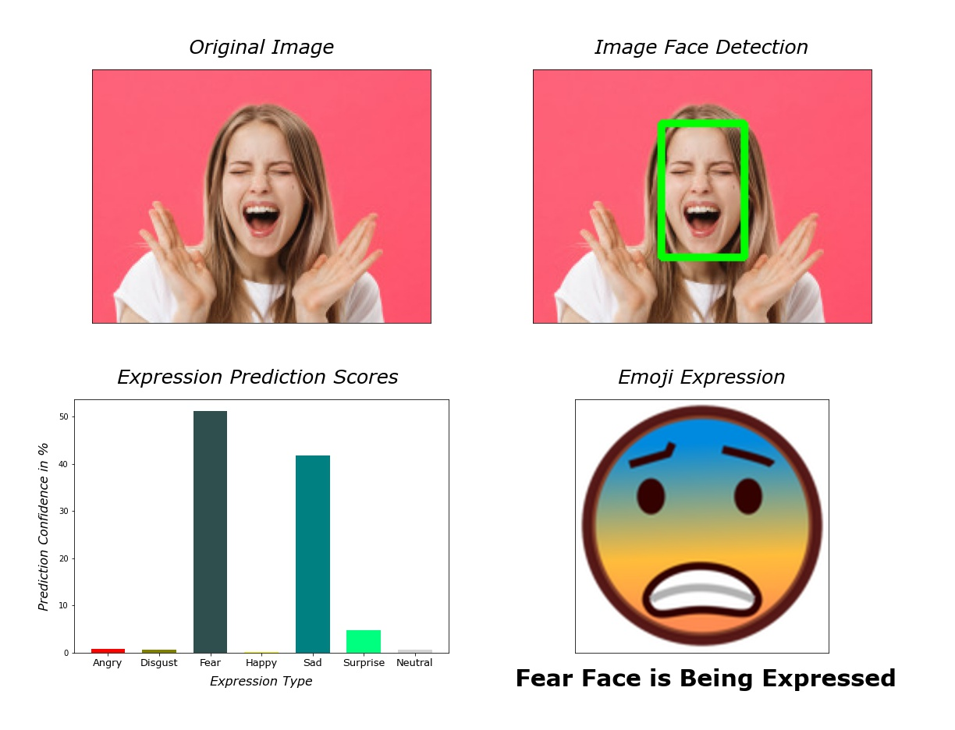
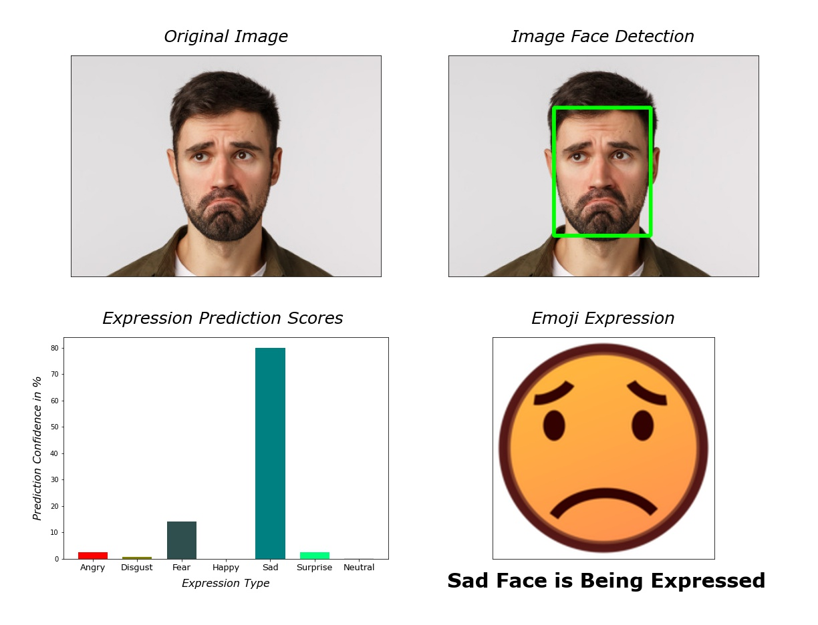
Prediction - Example

Slide 17
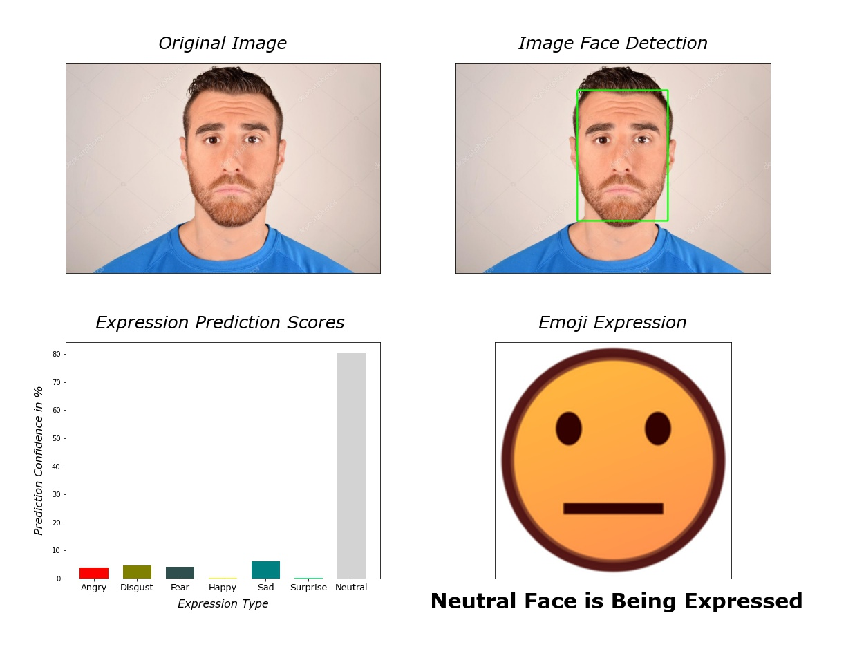
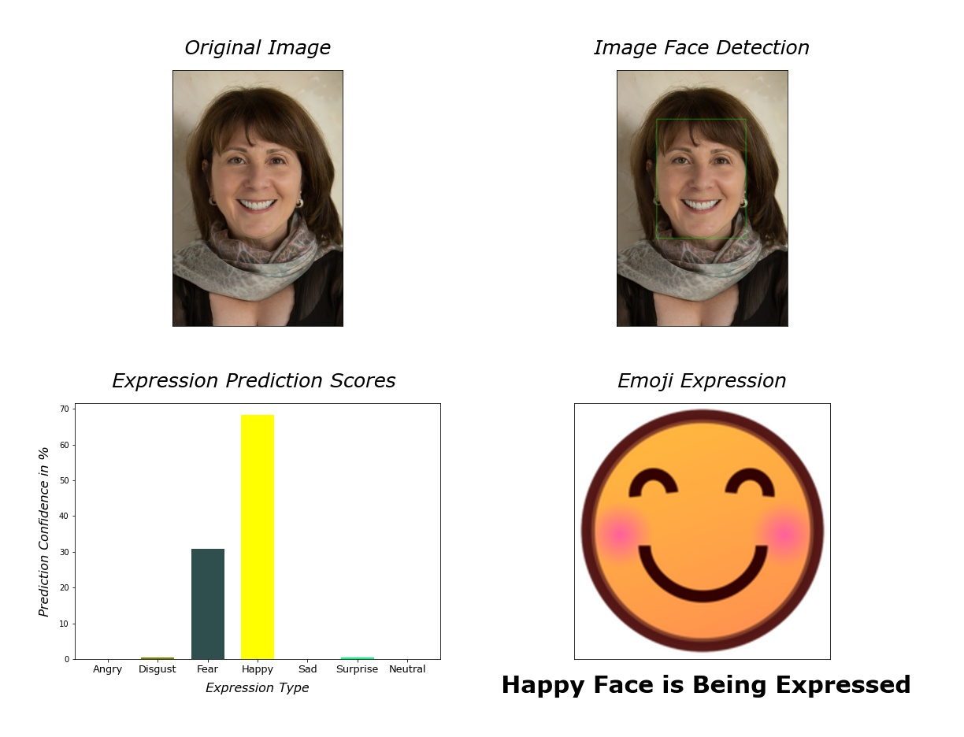
Prediction - Example

Slide 18
Conclusion
The CK+ dataset proved to be a very useful dataset to use for creating a model using deep convolutional neural networks.
Both VGG19 and ResNet18 Model Architecture led to the creation of very accurate models with low loss rates.
The models were not perfect as both neural networks struggled slightly when distinguishing between some emotions. VGG19 struggled slightly when learning disgust, sadness, and surprise.
ResNet18 struggled slightly when learning anger, disgust, fear, sadness, surprise, and contempt. Therefore, when deciding which model to use for making expression predictions, VGG19 was the natural choice.
When predicting expressions the model struggled when the image did not have a plain background and it also struggled to distinguish between subtly different emotions when in practice on real world images.
Future work would focus on obtaining a larger dataset with more training data that shows a bit more variation in the expressions for each emotion and also creating a webcam app to use in real time for individuals such as my sister-in-law.

Slide 19
Questions?

